Slide 1

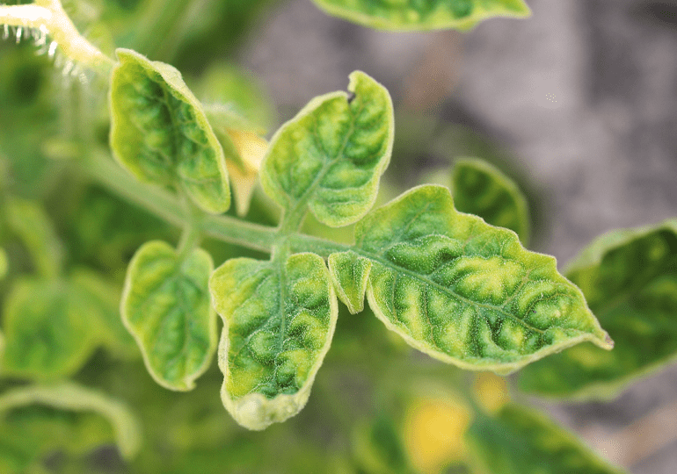
PLANT DISEASE PREDICTION
MADE BY-
SEJAL GUPTA(2000290120140)
YASH SRIVASTAVA(2000290197)
HARSH SRIVASTAVA(2000290130076)

Slide 2
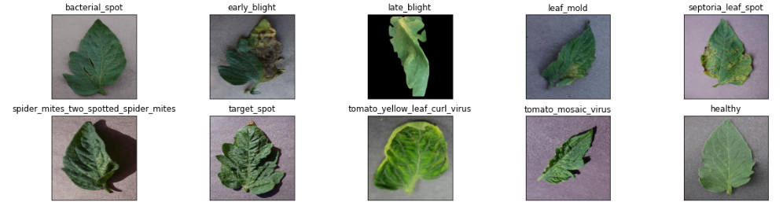
INTRODUCTION
Automatic detection of the diseases by just seeing the symptoms on the plant leaves makes it easier also machine vision to provide image based automatic process control. Image segmentation is grouping an image into different parts. In this Thresholding process is advanced color method This process is based on various features found in the image. Genetic algorithm searches from a large sampling of the cost surface. Large number of variables can be processed and Gives a number of optimum solutions, different image segmentation results can be obtained.

Slide 3
PROBLEM STATEMENT
Agriculture is an integral part of the Indian economy. The Indian agriculture sector employs nearly half of the country's workforce. India is the second largest producer of Tomatoes in the world.
Plants are highly susceptible to diseases that inhibit plant development, which has an effect on the farmer's ecology. The use of an automated disease detection technique is advantageous in detecting a plant disease at an early stage. Plant diseases manifest themselves in various parts of the plant, such as the leaves.
It takes a long time to manually diagnose plant disease using leaf photographs. As a result, computational methods must be developed to automate the process of disease detection and classification using leaf images.

Slide 4
PROPOSED IDEA To develop a model which can accurately detect various diseases in plants with the help of plant leaf images using Deep Learning (Convolutional Neural Network) and Machine Learning Techniques.
OBJECTIVES
To process the data of the leaf picture from plant dataset.
Extract the feature from pre-processed data.
Accurately classify the leaf disease.
Evaluate performance analysis

Slide 5
EXISTING SYSTEM
The existing method for plant disease detection is simply naked eye observation by experts through which identification and detection of plant diseases done.
DISADVANTAGES
We need large team of experts to detect diseases.
Continuous monitoring of plants is required.
Cost of existing system is high when we implemented for large farms.
Farmers do not have proper facilities.

Slide 6
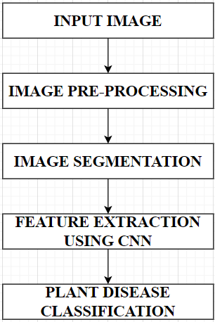
FLOWCHART
ADVANTAGES
At very early stage itself it detects the symptoms of diseases.
Automatic detection of the diseases by just seeing the symptoms.
Also supports machine vision to provide image based automatic process .

Slide 7
EXPECTED OUTCOME
The proposal of our idea is to classify various diseases of crop, as well as an algorithm for image segmentation that can be used for automated detection and classification of plant leaf diseases in the future.
Another benefit of this approach is that plant diseases can be detected at an early stage, or even at the beginning. Convolution neural network and Deep neural network algorithms may be used to increase recognition rates in the classification process.
FUTURE SCOPE
Our model can be extended to detect multiple diseases for multiple crops.
The Efficiency can be further improved.
Our model can be implemented in real time mobile applications and web services, so farmers can identify diseases simply by clicking photos of the infected leaf.
Our model can recommend pesticides and insecticides to control the further spread of disease on the different parts of the plants after proper identification of the diseases.

Slide 8
THANK YOU

